Slide 1
SPRING VALLEY VILLAGE POLICE DEPARTMENT
MONTHLY NEWSLETTER:
JULY 2024
1025 CAMPBELL ROAD
HOUSTON, TX 77055
PHONE: 713-465-8323
COMMUNITY MATTERS.
WE ARE A TEAM.

Slide 2
INTRODUCTION
Hilshire Village Residents,
Summer is here! Hopefully everyone is being cautious in the summer heat that is upon us.
KEEP IN MIND:
Fireworks are not permitted within the city limits of Hilshire Village.
Lock your vehicle when it is unoccupied.
Be sure to lock all doors and windows in your home, when you are not on the premises.
As always we are here if you need us!
Sincerely,
Chief M. Schulze
1025 CAMPBELL ROAD, HOUSTON, TX 77055
PHONE: 713-465-8323 / EMAIL: DISPATCH@SPRINGVALLEYTX.COM

Slide 3
JULY 2024
DATE | DAY | SPECIAL DAYS FOR THIS MONTH
07-04-2024 | THURSDAY | FOURTH OF JULY
07-04-2024 | THURSDAY | CITY HALL CLOSED
COMMUNITY MATTERS.
WE ARE A TEAM.
1025 CAMPBELL ROAD, HOUSTON, TX 77055 / PHONE: 713-465-8323 / EMAIL: DISPATCH@SPRINGVALLEYTX.COM

Slide 4
1025 CAMPBELL ROAD, HOUSTON, TX 77055
PHONE: 713-465-8323 / EMAIL: DISPATCH@SPRINGVALLEYTX.COM

Slide 5
SPRING VALLEY POLICE DEPARTMENT
HILSHIRE VILLAGE
CALLS BY TYPE: 06-01-2024 THRU 06-30-2024
TYPE | DESCRIPTION | # OF CALLS
22 | ALARM | 9
23 | AMBULANCE CALL | 3
24 | ANIMAL CALL | 3
135 | BUSINESS CHECK | 887
60 | FIRE CALL | 1
68 | HOUSE CHECK | 89
70 | INFORMATION | 9
71 | INVESTIGATION | 1
162 | PARKING VIOLATION | 2
86 | PUBLIC RELATIONS | 55
97 | SPECIAL ASSIGNMENT | 22
99 | STALLED VEHICLE | 1
103 | SUSPICIOUS ACTIVITY | 1
104 | SUSPICIOUS PERSON | 1
108 | TRAFFIC CONTROL | 5
11 | TRAFFIC STOP | 21
111 | VEHICLE BLOCKING ROADWAY | 1
163 | VIOLATION OF CITY ORDINANCE | 4
 | TOTAL | 1115
COMMUNITY MATTERS.
WE ARE A TEAM.
1025 CAMPBELL ROAD, HOUSTON, TX 77055
PHONE: 713-465-8323 / EMAIL: DISPATCH@SPRINGVALLEYTX.COM

Slide 6
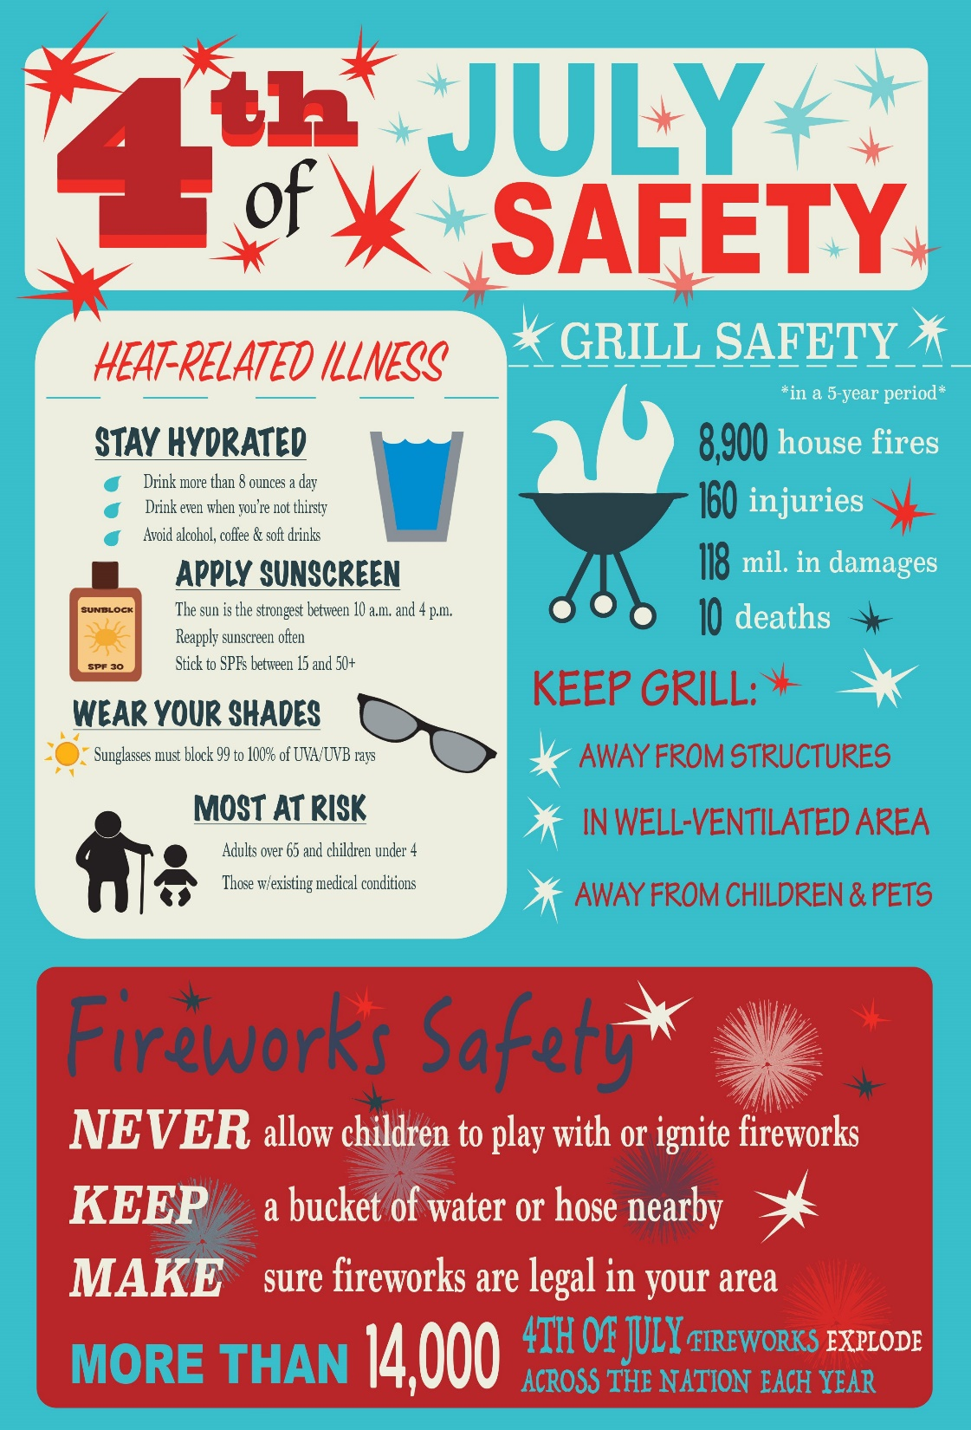
COMMUNITY MATTERS.
WE ARE A TEAM.
1025 CAMPBELL ROAD, HOUSTON, TX 77055 / PHONE: 713-465-8323 / EMAIL: DISPATCH@SPRINGVALLEYTX.COM

Slide 7
IMPORTANT NUMBERS AT A GLANCE
EMERGENCY |  | NON - EMERGENCY
911 - FOR ALL EMERGENCY |  | 713-465-8323
988 – NATIONAL SUICIDE & MENTAL HEALTH
SPRING VALLEY VILLAGE |  | VILLAGE FIRE DEPARTMENT
SPRING VALLEY - CITY HALL | 713-465-8308 | VILLAGE FIRE DEPARTMENT |  | 713-465-2323
SPRING VALLEY - PD | 713-465-8323 | VFD - NON-EMERGENCY |  | 713-468-7941
SPRING VALLEY - PD FAX | 713-465-3135
SPRING VALLEY - COURT | 713-465-0333
HILSHIRE VILLAGE
HILSHIRE VILLAGE – CITY HALL | 713-973-1779
COMMUNITY MATTERS.
WE ARE A TEAM.
1025 CAMPBELL ROAD, HOUSTON, TX 77055 / PHONE: 713-465-8323 / EMAIL: DISPATCH@SPRINGVALLEYTX.COM

